Slide 1
GNU/Linux Fundamentals
Part 1
By Aliaksandr Stelmachonak, Dzmitry Kuchko
Notes:
1
1

Slide 2
Common definitions and history
2
Notes:
2

Slide 3

What is Linux?
Linux
?
3
Notes:
3
3

Slide 4

What is Linux?
GNUs
?
Richard Stallman
4
Notes:
4
4

Slide 5

What is Linux?
Linus
?
Linus Torvalds
5
Notes:
5
5

Slide 6
What is Linux?
GNU / Linux
GNU (GNU is Not Unix)‏
is a computer
operating system composed entirely of
free software
Linux (kernel)‏
Unix-like
operating system
kernel
6
Notes:
6
6

Slide 7

What is Linux?
Linux is
Unix-like computer operating system
one of the most prominent examples of free software and open source development
7
Notes:
7

Slide 8
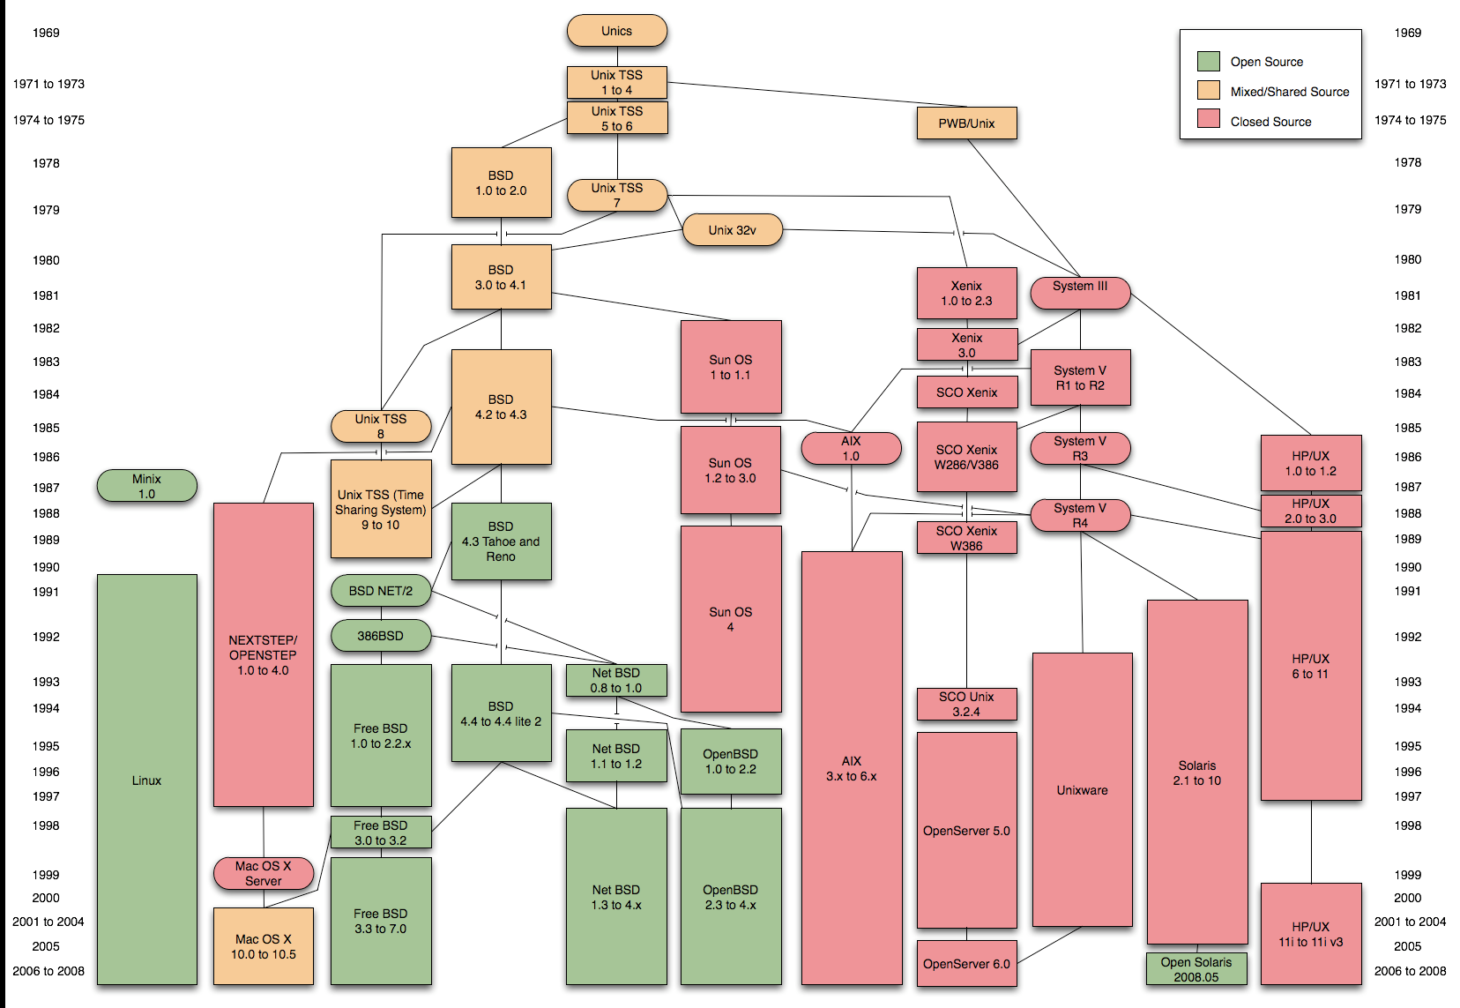
The world of UNIXes
8
Notes:
8

Slide 9

Linux distributions
A Linux distribution is a member of the family of Unix-like software distributions built on top of the Linux kernel.
There are currently over three hundred Linux distributions. Most of those are in active development, constantly being revised and improved.
9
Notes:
9

Slide 10




Linux distros hierarchy
Slamd64
MOPSLinux
Zenwalk
SUSE Linux
OpenSUSE
Red Flag
Yellow Dog
CentOS
Mandrake/Mandriva
Fedora
Knoppix
Xandros
Lindows/Linspire/Freespire
SimplyMEPIS
Ubuntu Family
Notes:
Yellow Dog – для PowerPC компьютеров, в частности для Sony Play Station 3!
Red Flag - ведущий дистрибутив в Китае и азиатском регионе.

Slide 11
General Differences between distros
Software Management
(rpm, yum VS deb, apt)
Configuration Files
(sysconfig, init.d VS classic config files, event.d)

Slide 12
Linux vs. Windows
Main differences:
Architecture (modular and monolithic kernel)
GUI Implementation
File System
Access rights
Notes:
http://www.fcenter.ru/online.shtml?articles/software/os/6773

Slide 13
Remote access
13
Notes:
13

Slide 14
Remote access
Console
Protocols:
Telnet
SSH (encrypted)‏
Programs
Putty (simple Telnet/SSH client)‏
WinSCP (offers basic file manager functionality, suitable for remote file copying)‏
X-System
X-System (server and client) uses client-server model and network-transparently protocol, can be used remotely
Using VNC server/client software
Notes:
14

Slide 15
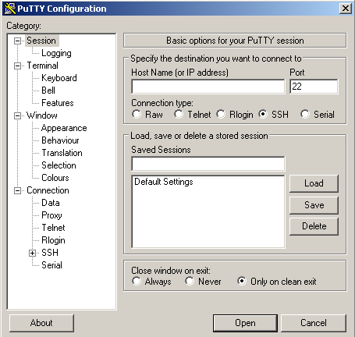
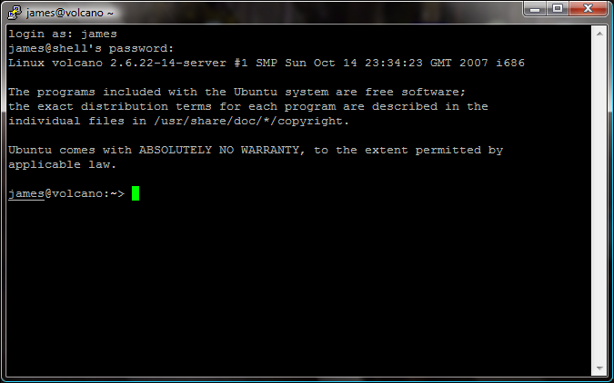
Remote access: putty
putty
or
putty -<protocol> <server> <options>
server name/ip
protocol (telnet/ssh)‏
more options
Notes:
15

Slide 16

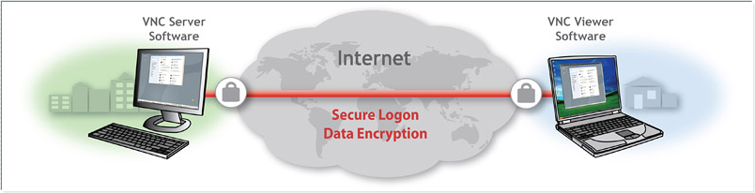
Remote access: VNC
A VNC system consists of a client, a server, and a communication protocol
VNC by default uses TCP ports 5900 through 5906, each port corresponding to a separate screen (:0 to :6)‏
Notes:
16
The VNC server is the program on the machine that shares its screen
The VNC client (or viewer) is the program that watches and interacts with the server
The VNC protocol (RFB) is very simple, based on one graphic primitives

Slide 17
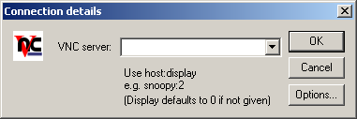
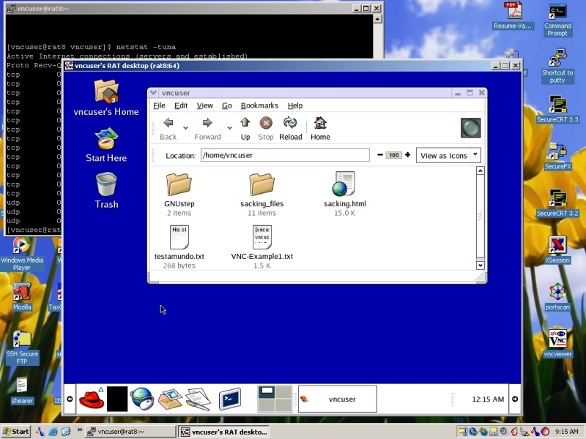
Remote access: VNC
Usage steps:
Start VNC server on a remote box
Run VNC Client on local computer
Enter remote server address and VNC screen number
Notes:
17

Slide 18
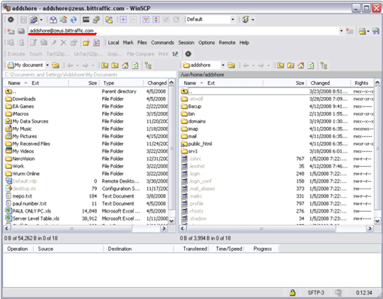
Remote access: WinSCP
main function is secure file transfer between a local and a remote computer
Support for SFTP and SCP protocols over SSH-1 and SSH-2 and plain old FTP protocol
Batch file scripting and command-line interface
Integrated text editor
Directory synchronization in several semi or fully automatic ways, etc...
open source SFTP and FTP client
Notes:
18

Slide 19
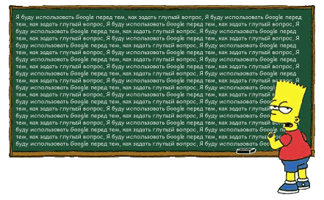
Questions? ☺

Slide 20
File systems
20
Notes:
20

Slide 21
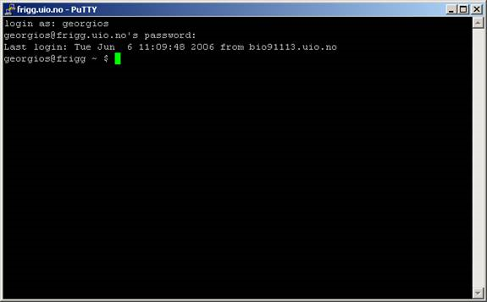
File system and shell
Where we currently are?
21
Notes:
21
21

Slide 22
File system – differences in structure
Unix/Linux
Supports a lot of file systems types: ext2, ext3, ReiserFS, etc.
Single hierarchy (tree) principal used - there is one root directory (/), and every file existing on the system is located under it somewhere;
There is no concept filename.extension - system doesn’t make any assumptions about the file content by its extension (extension is optional).
Windows
Supports NTFS, FAT16 & FAT32 file systems only
uses a drive letter abstraction - files are located on disks (or partitions) represented by letters (A:,B:,C:, ... Z:)‏
System behaviour related to file format and its content bases on it’s extension (.exe is executable file, .txt is a text file, etc).

Slide 23
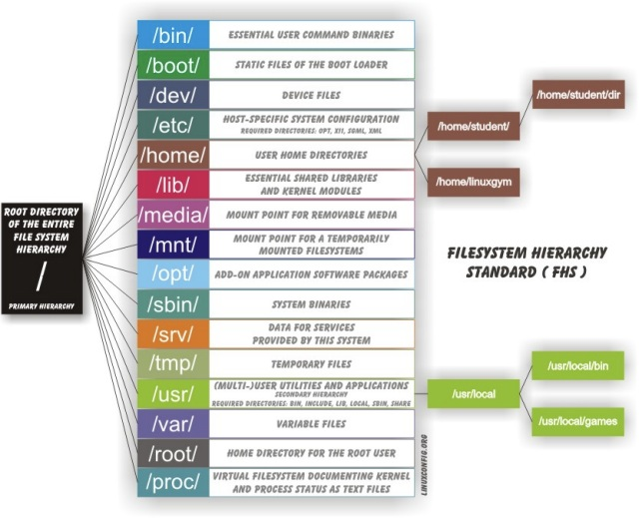
Linux file system structure

Slide 24
Basic commands
24
Notes:
24

Slide 25
manual
man – main UNIX help. This is a command for working with system manual.
Example:
man cat Get full guide for “cat” command
man man Prints a list of options and description of man command
man –k list Prints a list of commands contains “list” in description
man –f ls Get short description of “ls” command
Notes:
Syntax:
man <command> - help about command
man man – UNIX guide
man –k <pattern> - print a list of all UNIX commands whose NAME section of their manual page contains the pattern you specify
25

Slide 26
information
info – information pages for commands, developed by GNU project.
Example:
info cat Get full guide for “cat” command
info info Prints a full description of info command
Notes:
Syntax:
man <command> - help about command
man man – UNIX guide
man –k <pattern> - print a list of all UNIX commands whose NAME section of their manual page contains the pattern you specify
26

Slide 27
Working with files
cd
ls
touch
cat
cp
mv
mkdir
rmdir and rm
cd
more
tail
grep

Slide 28
list of files
ls – view information about files or directories (list)
Example:
ls –l
Result:
lrwxrwxrwx
1
root
root
14
Янв
22
14:59
aliases -> ./mail/aliases
drwxr-xr-x
2
root
bin
512
Янв
22
15:53
apache
-rw-r--r--
1
root
root
12
Янв
23
08:35
defaultrouter
-r--r--r--
1
root
root
1825
Янв
22
15:42
device.tab
file types
drwxr-xr-x
1
root
sys
2467
Янв
22
15:02
devlink.tab
prw-------
2
root
sys
512
Янв
22
14:54
dfs
prw-------
1
root
root
0
Янв
16
15:50
initpipe
-rw-r--r--
1
root
sys
1087
Янв
23
08:33
inittab
Notes:
Syntax:
ls [-l][-a][i][t] <file/directory_name>
-l Show all files, including that who’s names begin from dot
-a Full information about file
-i Show numbers of i-nodes
-t Sort files by time of modifying
28

Slide 29
File types
All objects in Linux are files! E.g. files itself, directories, devices, network connections, running processes, etc.
Unix recognizes the following types of files :
Regular file (-)
Executable file (-)
Directory (d)
Symbolic link (l)‏
Socket (s)
Device special files (b and c)‏
Named pipe (p)‏
Notes:
Regular file (-) – text or binary data (e.g. an image).
Directory (d) – contains other files and directories.
Symbolic link (l) – file is a "shortcut" that points to another file.
Device special files (b and c) – an interface to a piece of hardware, such as a printer. You don't have to worry about this.
Named pipe (p) – an interface to a network program. You don't have to worry about this.
29

Slide 30
Names of files and directories limitations
File/directory naming rules:
255 symbols max
Case sensitive
* ? | ^ / \ ~ [ ] – { } ‘ “ - do not use this special symbols (not allowed or not recommended)
Notes:
UNIX filenames can be very long, up to 255 characters in length. Full name of file should not be more than 1023 characters
Filenames, like UNIX commands are Case Sensitive. UPPER CASE filenames are different from lower case file names. (“Alliance” and “alliance” – different names).
It is best if you do not use the following characters in a UNIX file name *&%$|^/\~ or - as the first character of a file name. Because those characters are interpreted by UNIX as commands.
You can use “.”, “-” and “_”.
30

Slide 31
pwd
pwd– show full path for current directory.
Example:
> pwd
/home/user/music/new
Notes:
Syntax:
man <command> - help about command
man man – UNIX guide
man –k <pattern> - print a list of all UNIX commands whose NAME section of their manual page contains the pattern you specify
31

Slide 32



change directory
cd – change directory
Example:
cd /var
cd log
cd ~
cd -
Go to /var directory
Go to log subdirectory
Go to home directory of current user
Go to the previous (last visited) directory
Notes:
Syntax:
cd <directory_name>
cd – go to home directory
Full name – is a name with full path
32

Slide 33

Create file
touch – create an empty file / change time label for given file
Example:
touch newfile.txt
touch newfile.txt
Create empty file “newfile.txt”
Modify creation date for “newfile.txt” for current time
Notes:
Syntax:
touch <filename>
33

Slide 34

make directory
mkdir – creation of empty directory
Example:
mkdir mydirectory
mkdir ~/tmp
Create empty directory “mytestdirectory” in current directory
Create empty directory “tmp” with given full path
Notes:
Syntax:
mkdir <directory_name>
34

Slide 35

copy file/directory
cp – copy file / directory with all subdirectories
Example:
cp newfile.txt ~/mydirectory
cp –r mydirectory ~/tmp
Copy mytest.file into ~/mydirectory
Copy directory mytestdirectory into ~/tmp
Notes:
Speak about .
35

Slide 36


Rename or move file
mv – renames or moves file
Examples:
mv mytest.file test.file
mv test.file ~
Rename file “mytest.file” to “test.file”
Move file “test.file” into /usr/progs/useless directory
Notes:
Syntax:
mv <old_filename> <new_filename> - rename
mv <filename> <path> - move
36

Slide 37


Rename or move directory
mv – rename or move directory
Example:
mv mydirectory mynewdir
mv mynewdir /tmp
Rename directory “mytestdirectory” to “mynewdir”
Move directory “mynewdir” to /tmp
Notes:
Syntax:
mv <old_directory_name> <new_directory_name> - rename
mv <directory_name> <path> - move
37

Slide 38

remove directory
rmdir– remove empty directory
Example:
rmdir /usr/mydir
Remove empty directory /usr/mydir
Notes:
Syntax:
rmdir <directory_name> - remove empty directory
rm –rf < directory_name > - remove not empty directory
38

Slide 39

remove file or directory
rm – remove file or directory
Example:
rm ~/newfile.txt
rm –rf /usr/local/squid/
Remove newfile.txt from home directory
Remove directory /usr/local/squid with all files and subdirectories
Notes:
Syntax:
rmdir <directory_name> - remove empty directory
rm –rf < directory_name > - remove not empty directory
39

Slide 40

Concatenation
cat – display content of file or combine files.
Example:
cat mytest.file
cat /etc/passwd /etc/group > mytest.file
Display content of file “mytest.file”
Read and combine two input files to the mytest.file
Notes:
Display content of file you can use the following commands: cat, more, less, pg or page. Cat allows to combine files.
Syntax:
cat <filename> - display content of file
40

Slide 41

view file content
less – display content of file by pages
Example:
less mytest.file
Display content of file “mytest.file” by pages
Notes:
Display content of file you can use the following commands: cat, more, less, pg or page. Cat allows to combine files.
Syntax:
cat <filename> - display content of file
more [keys] <filename> - display text one screen at a time
41

Slide 42
view file header
head – display first 10 lines of a given file
Example:
head mytest.file
Notes:
Display content of file you can use the following commands: cat, more, less, pg or page. Cat allows to combine files.
Syntax:
cat <filename> - display content of file
more [keys] <filename> - display text one screen at a time
42

Slide 43
view file last lines
tail – display last 10 lines of a given file
Example:
tail mytest.file
tail –n 15 mytest.file
tail –f mytest.file
Display last 15 lines of a file
follow the last 10 lines of file contonuosly
Notes:
Display content of file you can use the following commands: cat, more, less, pg or page. Cat allows to combine files.
Syntax:
cat <filename> - display content of file
more [keys] <filename> - display text one screen at a time
43

Slide 44
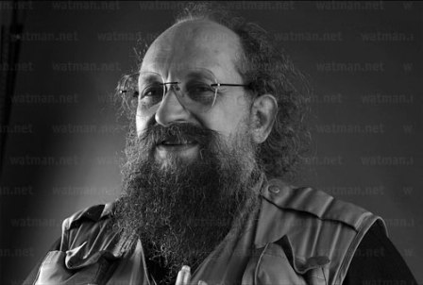
Useful link
To get more theoretical knowledge, refer to intuit.ru:
http://www.intuit.ru/department/os/linux/class/free/
Notes:
Display content of file you can use the following commands: cat, more, less, pg or page. Cat allows to combine files.
Syntax:
cat <filename> - display content of file
more [keys] <filename> - display text one screen at a time
44

Slide 45

Questions? ☺

